Slide 1
Financial Risk Analysis Dashboard
Nishanth Reddy Hanmanthureddygari
Satheesh Meadi

Slide 2

Project Overview
What is the Financial Risk Analysis Dashboard?
Interactive web-based portfolio analysis tool
Real-time financial data analysis and visualization
Advanced portfolio optimization capabilities
Comprehensive risk assessment platform
Target Users:
Investment analysts
Portfolio managers
Individual investors
Financial advisors

Slide 3
Core Technologies
Technical Stack
Frontend:
Streamlit (Web Framework)
Plotly (Interactive Visualizations)
Backend:
Python
Pandas & NumPy (Data Processing)
yfinance (Market Data)
SciPy (Optimization)
scikit-learn (Statistical Analysis)

Slide 4
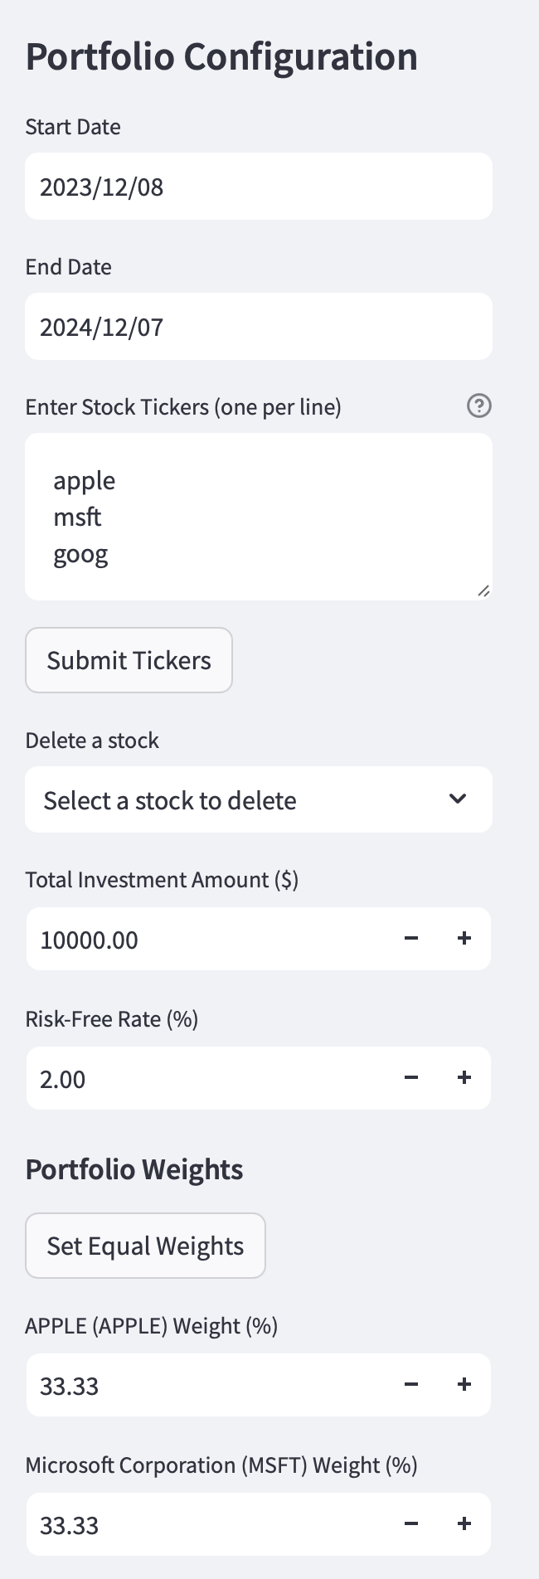
Key Features - Portfolio Management
Portfolio Configuration
Dynamic stock ticker input
Flexible weight allocation
Custom investment amount setting
Risk-free rate adjustment

Slide 5
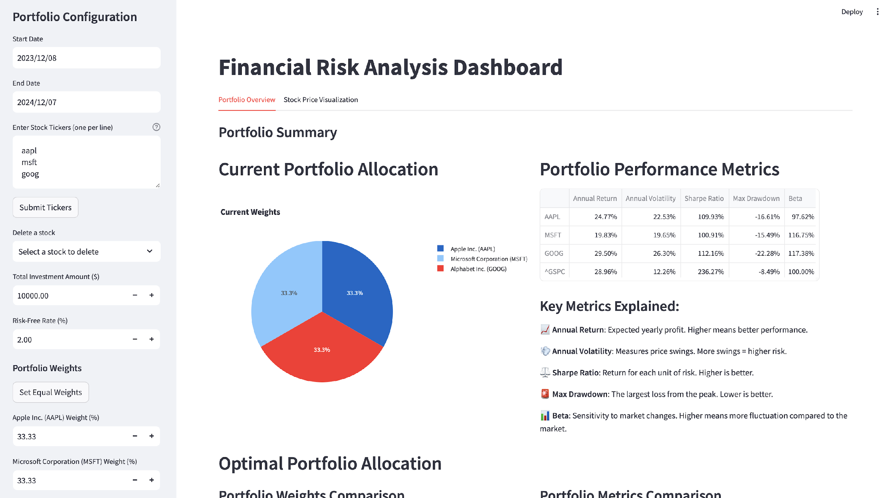
Portfolio Analysis
Comprehensive Analytics
Performance metrics calculation
Annual returns
Volatility
Sharpe ratio
Maximum drawdown
Portfolio allocation visualization
Risk-return analysis

Slide 6
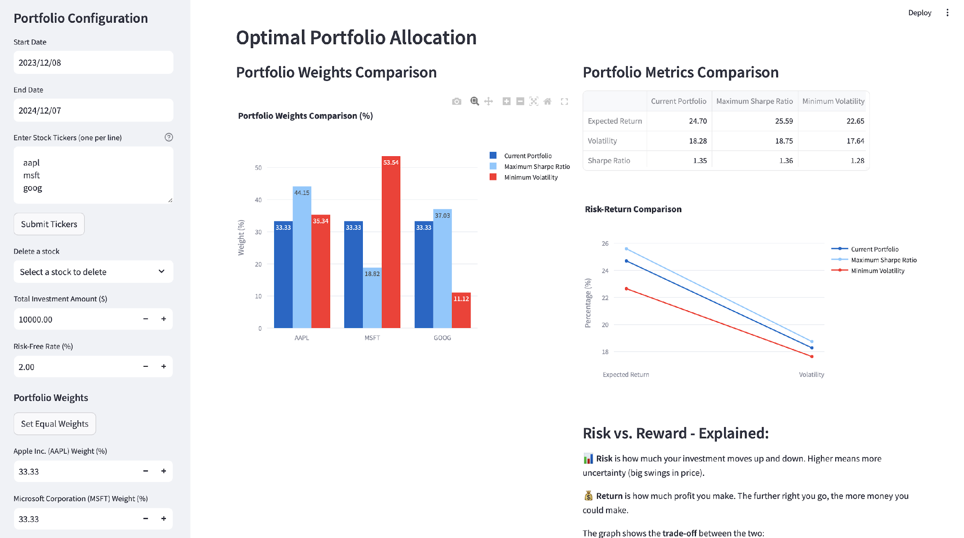
Advanced Features - Portfolio Optimization
Optimization Strategies
Maximum Sharpe Ratio portfolio
Minimum Volatility portfolio
Efficient Frontier visualization
Weight optimization

Slide 7
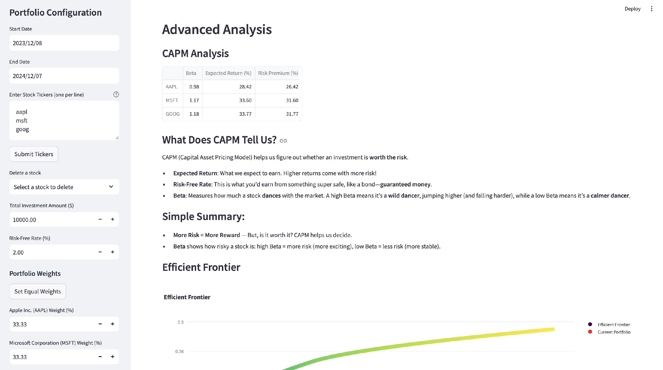
Advanced Features - CAPM Analysis
Capital Asset Pricing Model
Beta calculation
Expected returns
Risk premium analysis
Market correlation

Slide 8
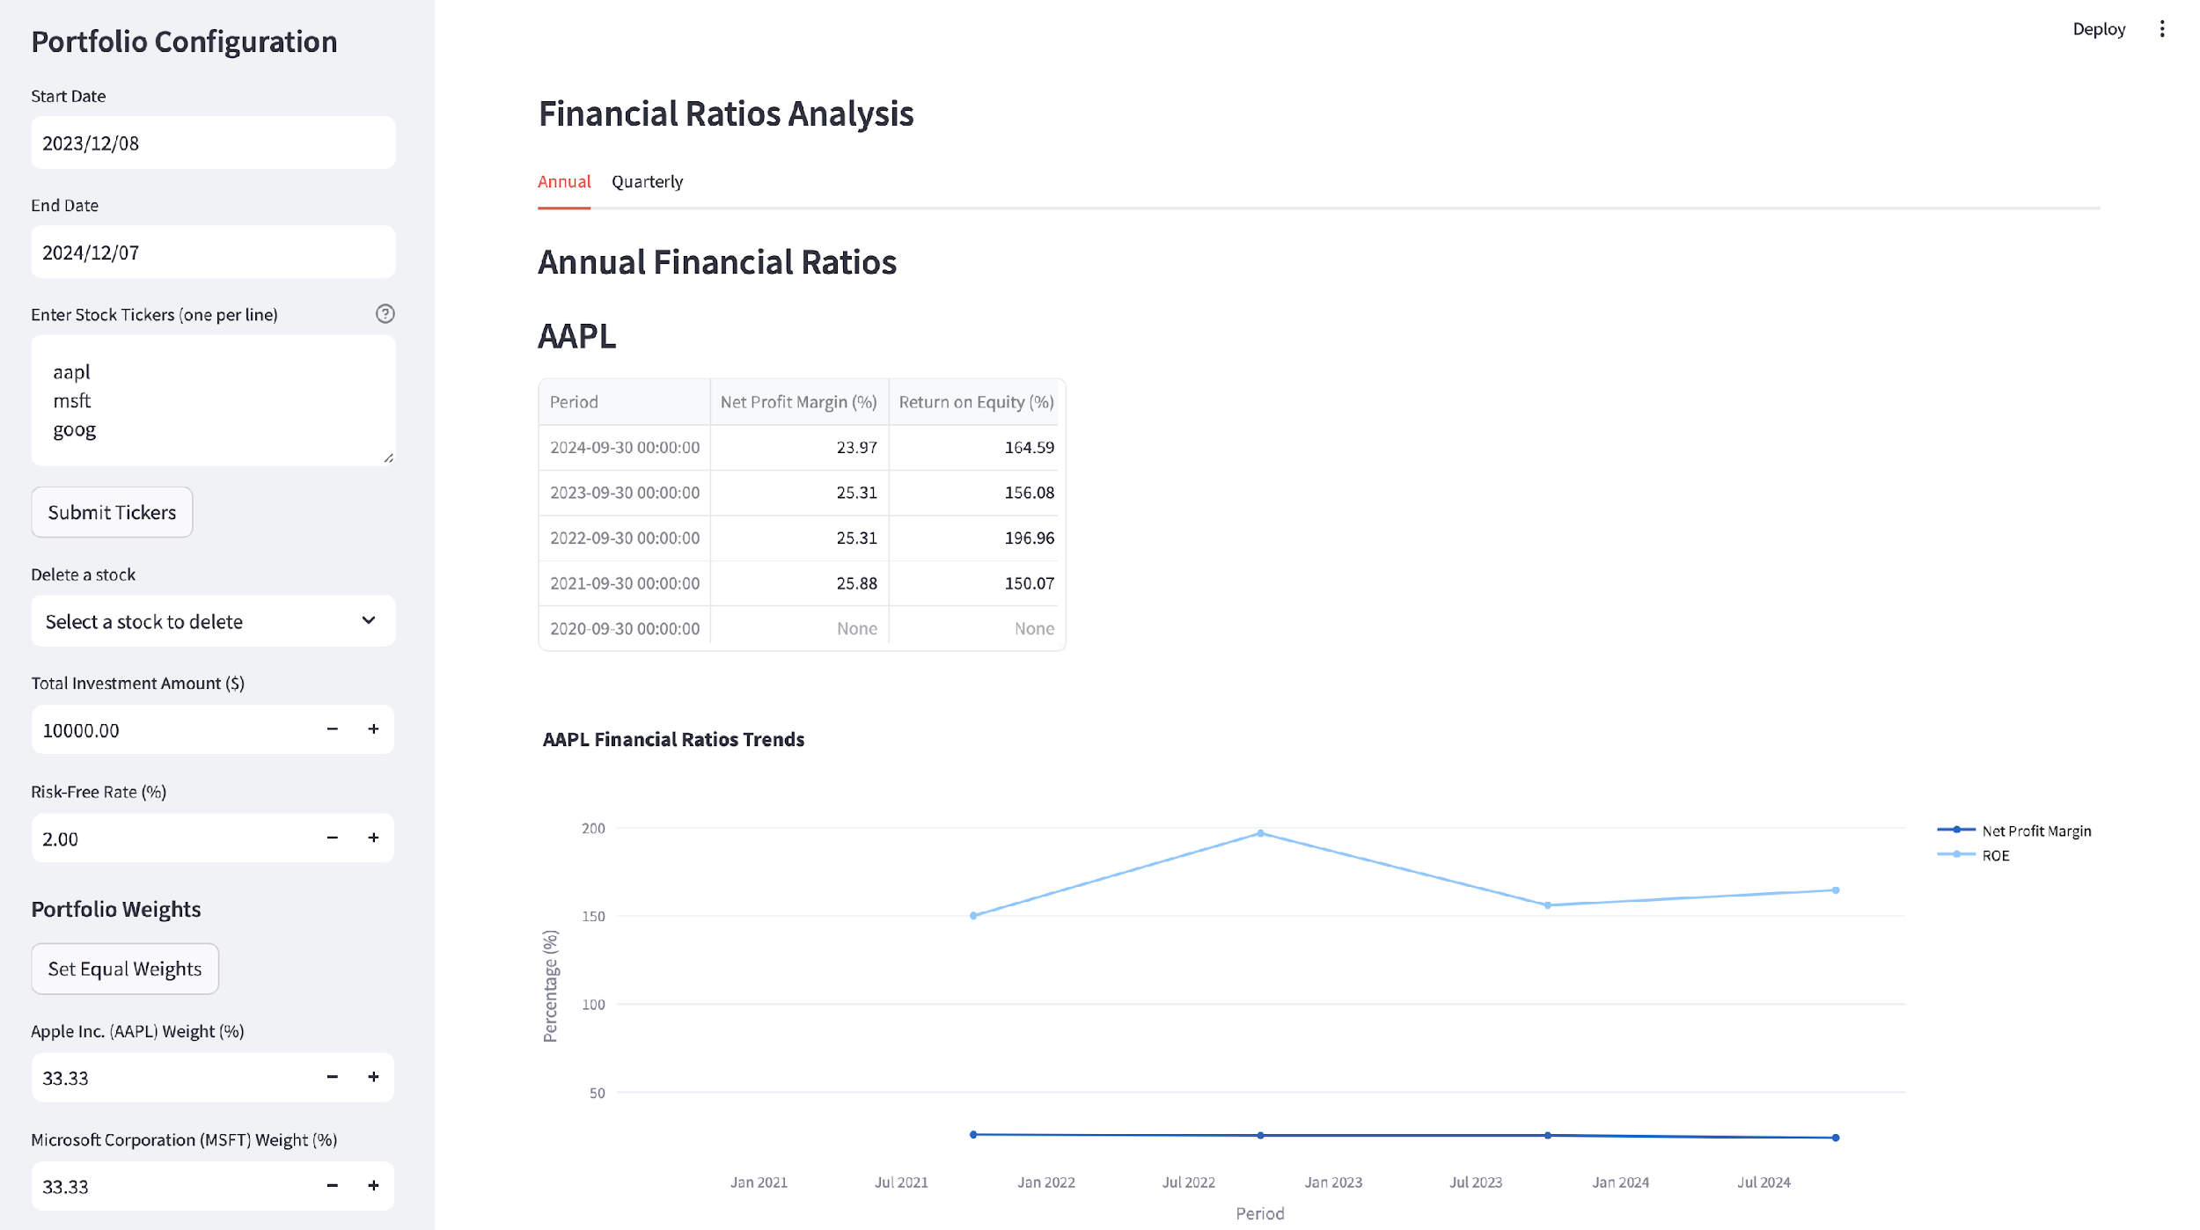
Financial Ratio Analysis
Detailed Financial Metrics
Quarterly and annual analysis
Net profit margin tracking
Return on equity (ROE)
Trend visualization

Slide 9
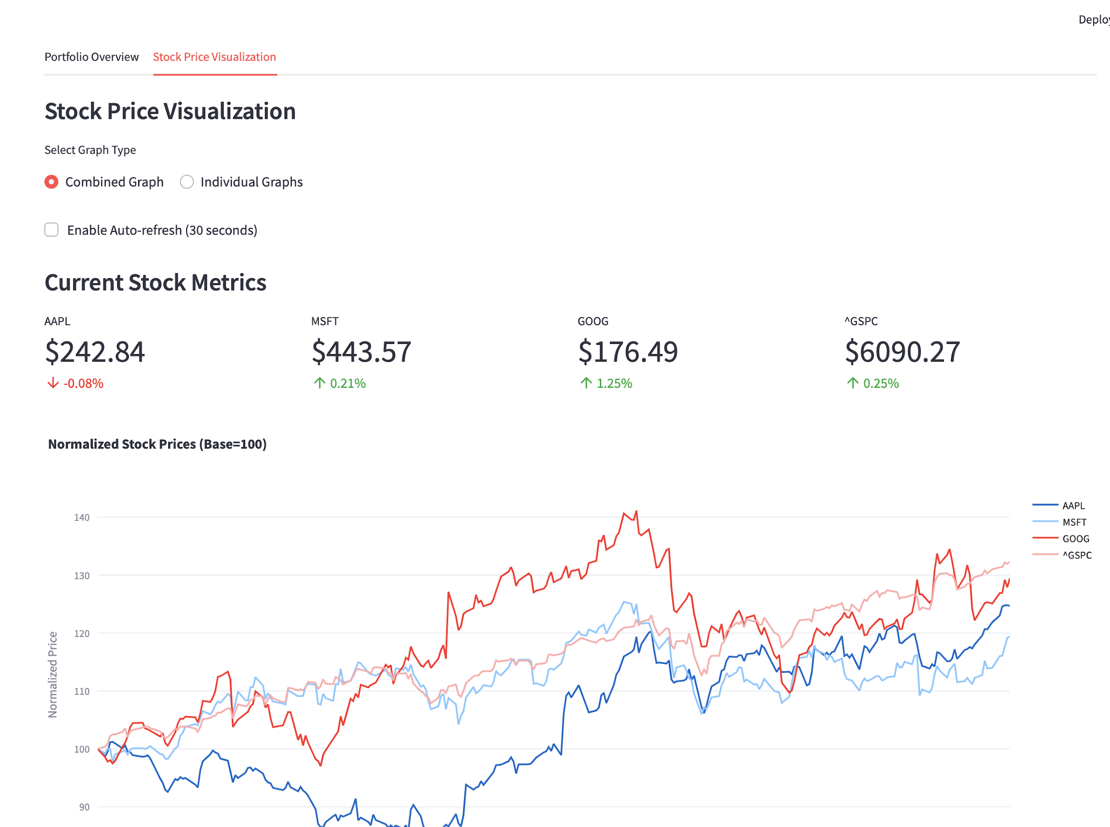
Key Features - Real-Time Analysis
Live Market Integration
Real-time stock price tracking
Auto-refresh capability
Current market metrics
Price change indicators

Slide 10
Interactive Visualizations
Data Visualization Capabilities
Interactive charts
Bar graphs
Performance comparisons
Time series analysis
Key Features:
Zoom functionality
Hover details
Dynamic updates
Custom time ranges

Slide 11
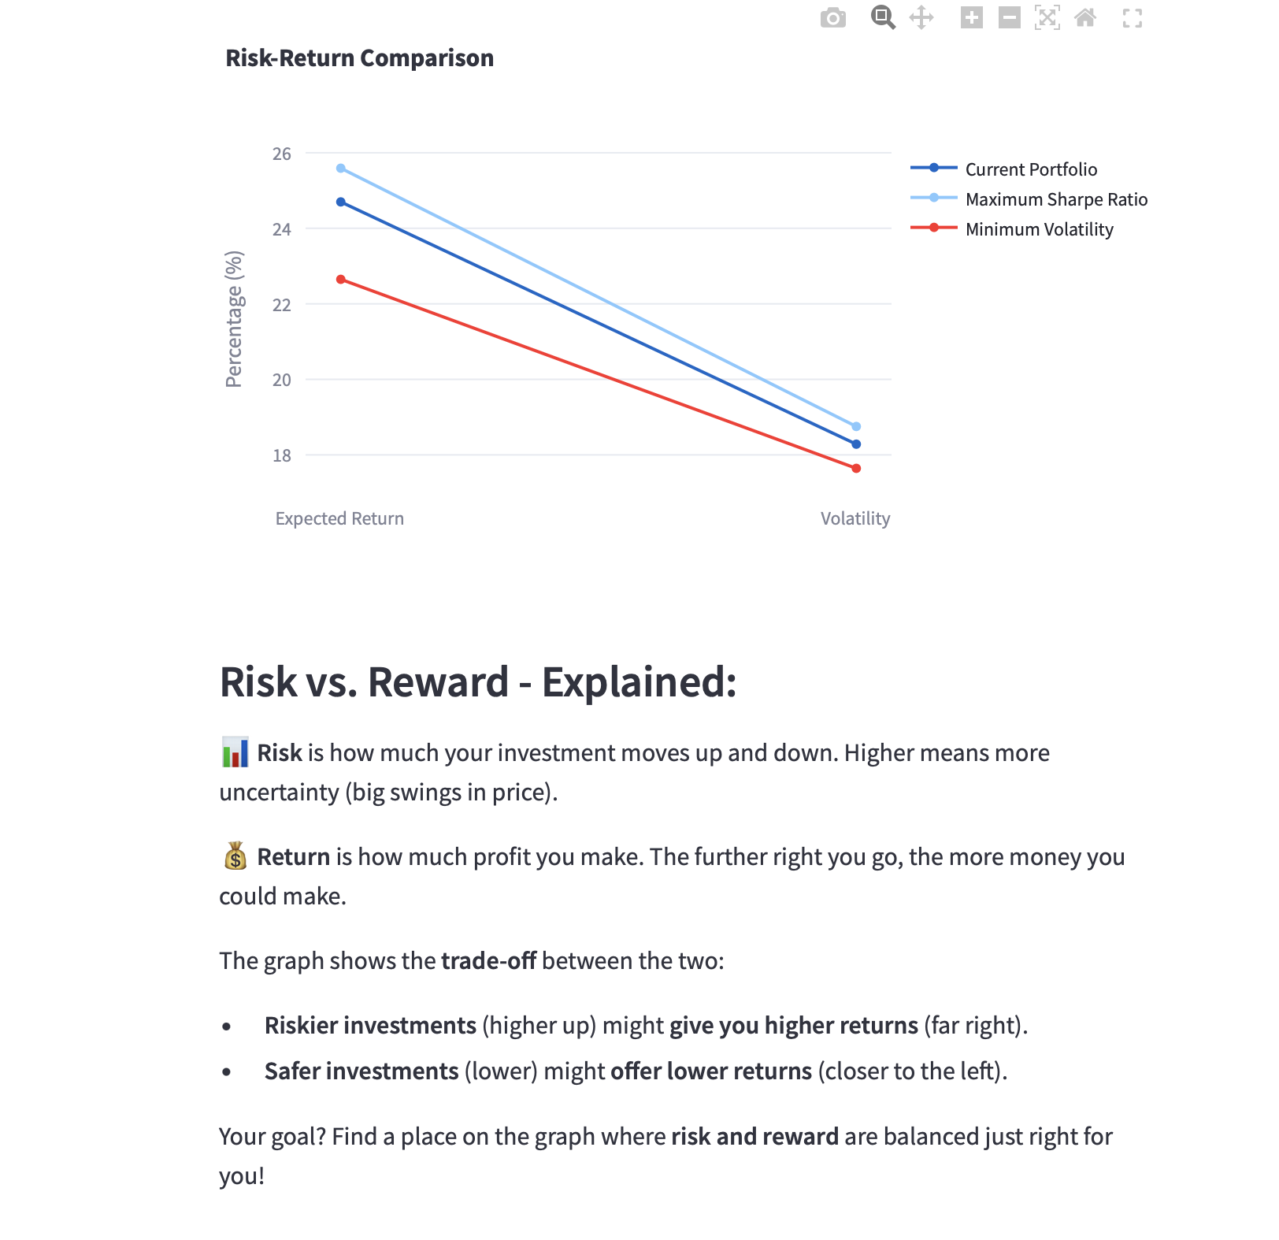
Risk Management
Risk Assessment Tools
Portfolio risk metrics
Market sensitivity analysis
Drawdown visualization
Risk-return trade-off

Slide 12
User Interface Design Intuitive Dashboard Layout Clean, modern interface Organized tab structure Responsive design User-friendly controls Key Components: Configurable sidebar Interactive main panel Clear data presentation Intuitive navigation | Technical Implementation Key Technical Achievements Real-time data integration Advanced optimization algorithms Statistical analysis implementation Interactive visualization creation Code Structure: Modular design Efficient data processing Scalable architecture Robust error handling

Slide 13
Future Enhancements Planned Features Short-term: Additional technical indicators Enhanced risk metrics Multiple portfolio comparison Long-term: Machine learning integration Alternative data sources Advanced risk modeling Portfolio rebalancing alerts | Benefits & Impact Value Proposition For Investors: Informed decision making Risk management Portfolio optimization Performance tracking For Analysts: Comprehensive analysis tools Real-time insights Efficient workflow Data-driven recommendations

Slide 14
Conclusion
Summary
Comprehensive portfolio analysis solution.
Real-time market integration.
Advanced optimization capabilities.
User-friendly interface.

Slide 15

Q&A
Thank You!
Questions?

